Slide 2
Science, and Society’s Unifying Mission
Jason Ross
April 7, 2016

Slide 4
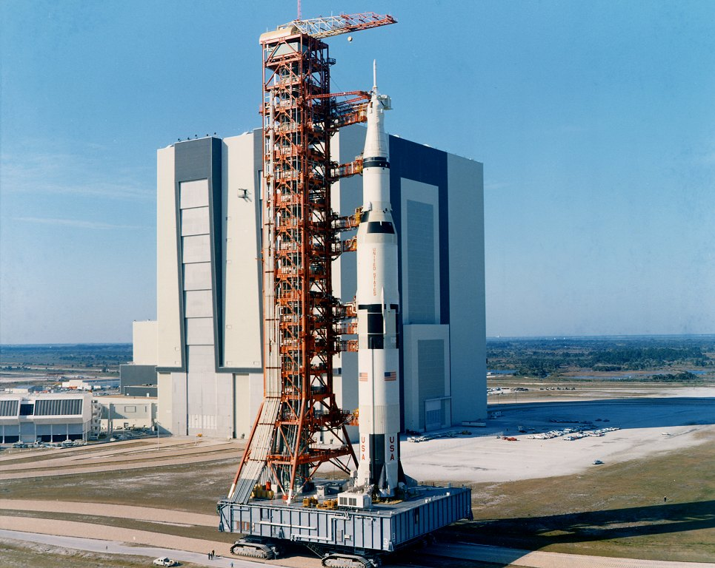
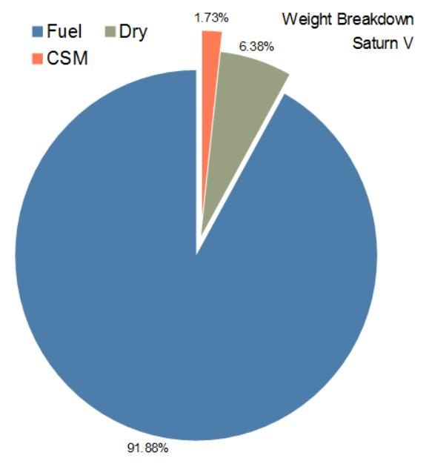

Slide 6
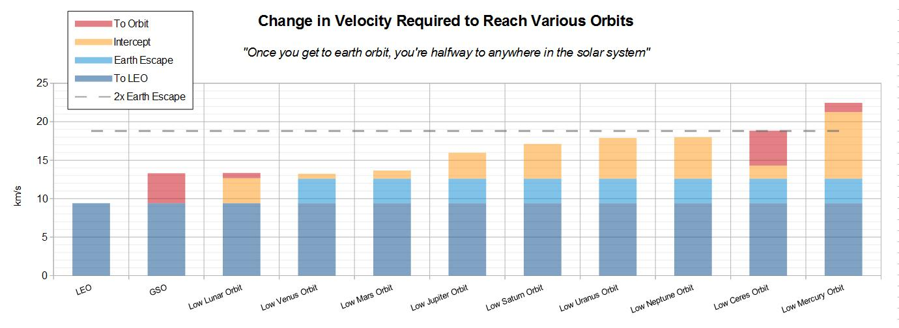

Slide 8
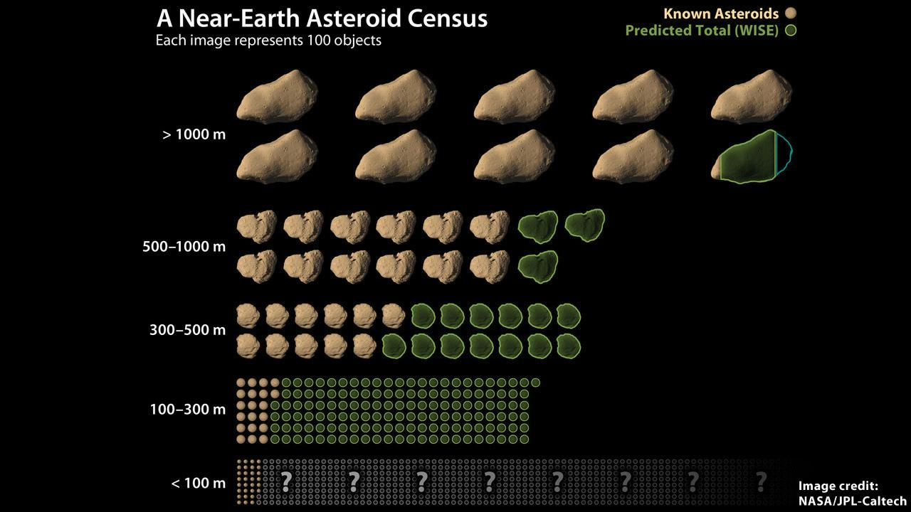
Asteroid Defense

Slide 10
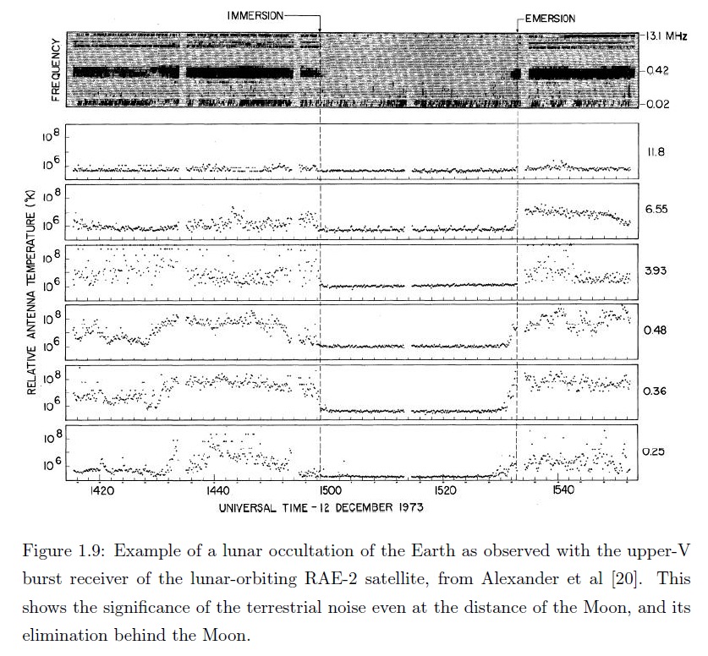

Slide 12
Science, and Society’s Unifying Mission
Jason Ross
April 7, 2016

Slide 13
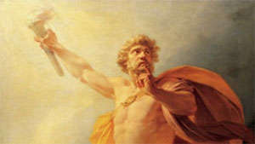
“Every art possessed by man comes from Prometheus.”

Slide 16
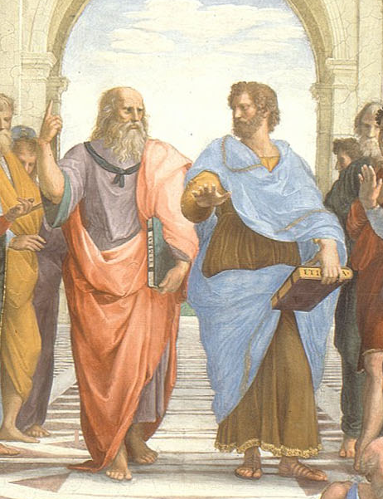
Plato and Aristotle

Slide 17
Plato, Timaeus
“For God desired that, so far as possible, all things should be good and nothing evil; wherefore, when He took over all that was visible, seeing that it was not in a state of rest but in a state of discordant and disorderly motion, He brought it into order out of disorder, deeming that the former state is in all ways better than the latter. For Him who is most good, it neither was nor is permissible to perform any action save what is most fair.”

Slide 18
Plato, Meno

Slide 19
Aristotle, De Anima
“Since, according to common agreement, there is nothing outside and separate in existence from sensible spatial magnitudes, the objects of thought are all in sensible forms. . . Hence, no one can learn or understand anything in the absence of senses. . .

Slide 20
Aristotle, De Anima
“While in respect of all the other senses we fall below many species of animals, in respect to touch, we far excel all other species in exactness of discrimination. That is why man is the most intelligent of all animals.”

Slide 21
Aristotle, Posterior Analytics
“All instruction given or received by way of argument proceeds from pre-existing knowledge…
“We have already said, that scientific knowledge through demonstration is impossible unless a man know the primary immediate premises. How does man know?

Slide 22
Aristotle, Posterior Analytics
“So our sense perception comes to be what we call memory and out of frequently repeated memories of the same things develops experience; for a number of memories constitute a single experience…
“From experience… originates… the knowledge of the man of science.”

Slide 23
1900

Slide 24
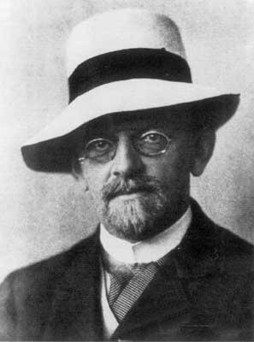
David Hilbert
[We must] establish the correctness of the solution by means of a finite number of steps based on a finite number of hypotheses…
[This] is simply the requirement of rigor in reasoning. Indeed, the requirement of rigor… corresponds to a universal philosophical necessity of our understanding. – Aug 1900

Slide 25
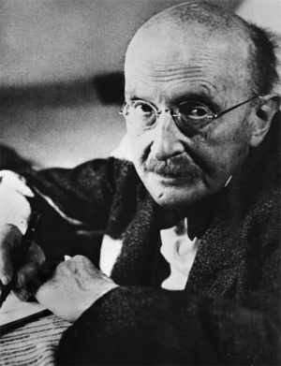
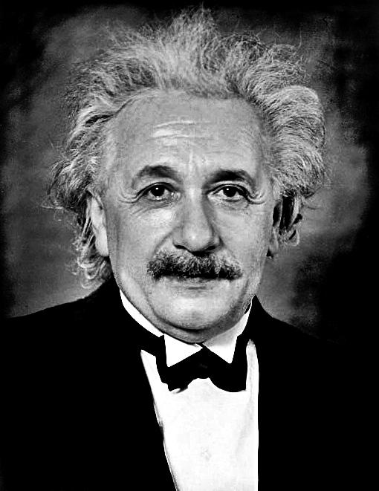
Max Planck and Albert Einstein
Notes:
They did NOT DERIVE FROM THE PAST. Driven by:
Desire to know
Paradoxes, not mathematics!
Besides Vernadsky, this was the last of science, the end. And Vernadsky was not put into practice the way these guys were. E=mc^2 means 100,000 times more power. Forget more efficient wave power, or windmills – use nuclear!

Slide 26
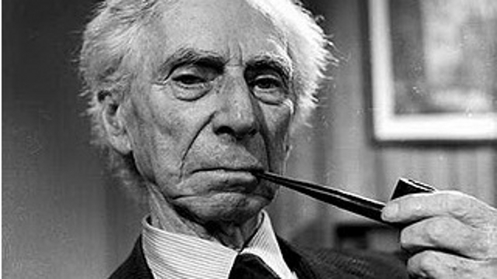
Bertrand Russell
1900: Planck
1903: Russell -
Principles of Mathematics
1905: Einstein
1910–1913: Russell - Principia Mathematica
1931: Gödel proves Russell is an idiot
1931: Russell writes about scientific dictatorship
1951: Russell writes about brainwashing
Notes:
Working with Hilbert to end all new ideas, to bring mathematics, and eventually physics, under logic. Logic has no meaning. All reasoning COULD BE DONE BY A COMPUTER! Gödel proved this is untrue.

Slide 27
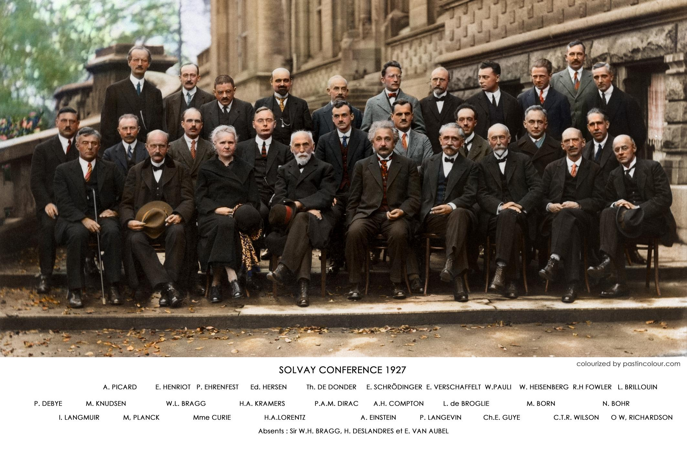
Einstein
Notes:
"The eternal mystery of the world is its comprehensibility."
• Quantum attacks in Solvay
• Bohr – “is” versus what we can “say”
• “We cannot solve our problems with the same thinking we used when we created them.”
• Cause does not depend on time. Kepler’s cause, Mendeleyev’s cause, Fermat’s cause, Leibniz’s cause, etc.

Slide 28
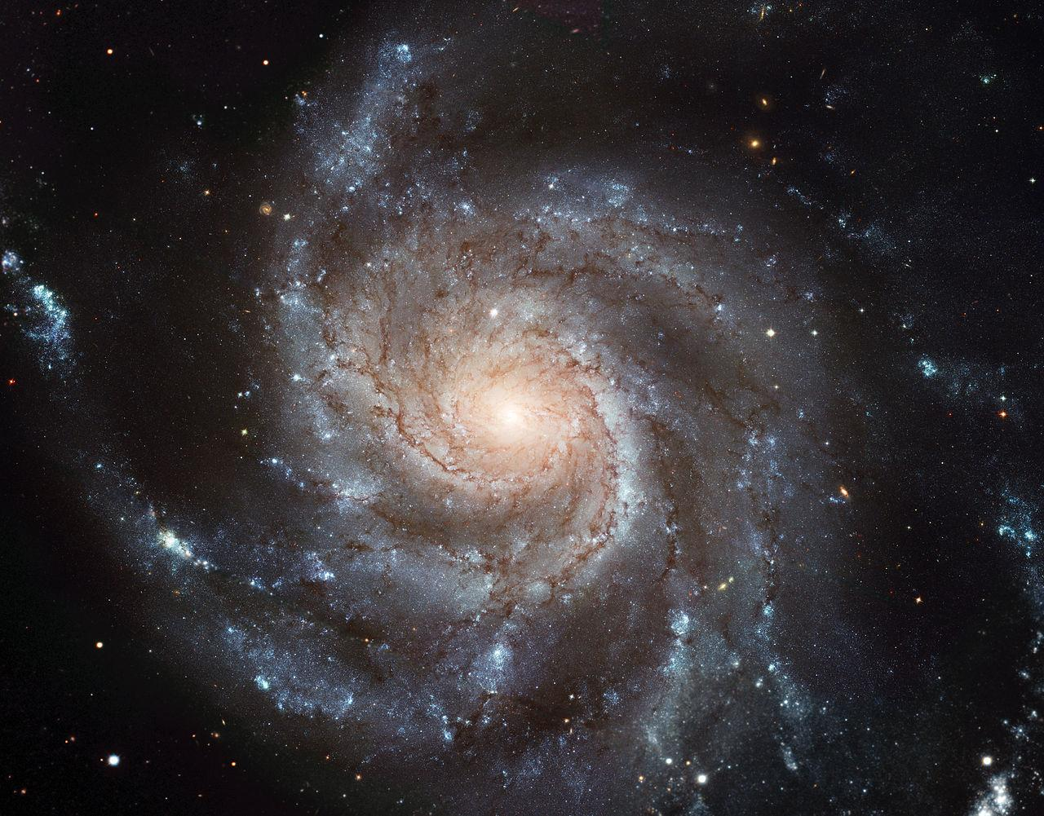
The Future
Notes:
Return to humanity. Throw off “purposelessness”. Throw off the cult of ugliness, of faux modernism, created by the CCF, the CIA, etc., throw off the compulsion to conclude that the universe is purposeless. It has a purpose, and it is the uniquely human creativity that we can express, and increase that power in the universe. Remember, WE ARE A FORCE OF NATURE. If the human mind has this power, what does that say about the universe? What should be our basis of relations among nations and among people? Purpose is a concept, that is essential.

Slide 29
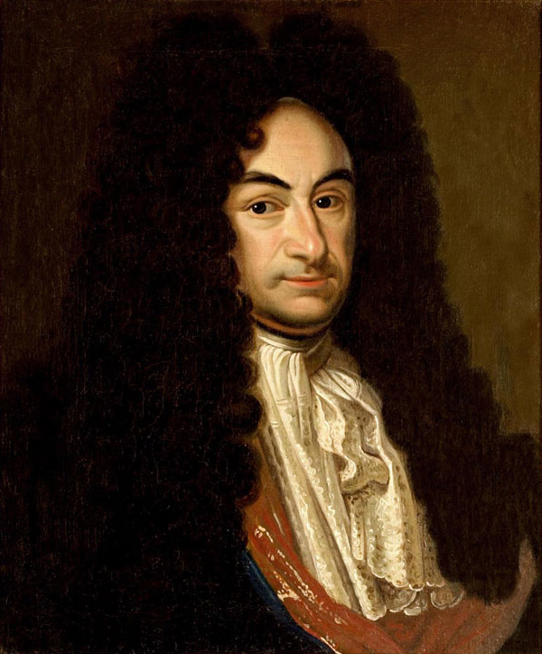
Leibniz

